Slide 1



Slide 2
3.SPOTS ANS STRIPES COME ALIVE
CONTENT:
. PLACES OF LIVING
.BODY COVERING
.MOVEMENT
.EATING HABITS
.TEETH
.CARING OF ANIMALS
CHAPTER 3/KARUNAMBIGAI/SCIENCE DEPT/SNS ACADEMY

Slide 3
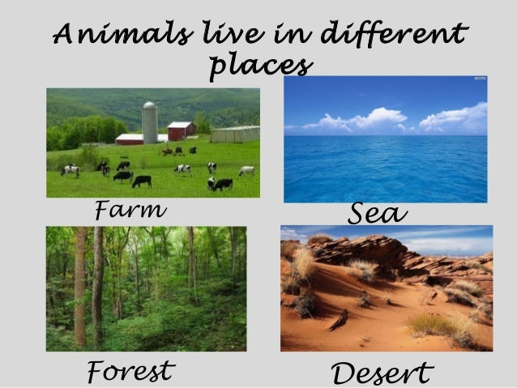
PLACES OF LIVING

Slide 4
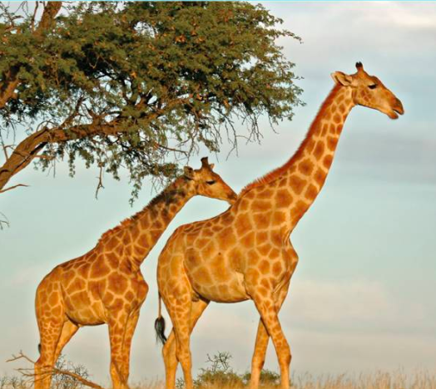

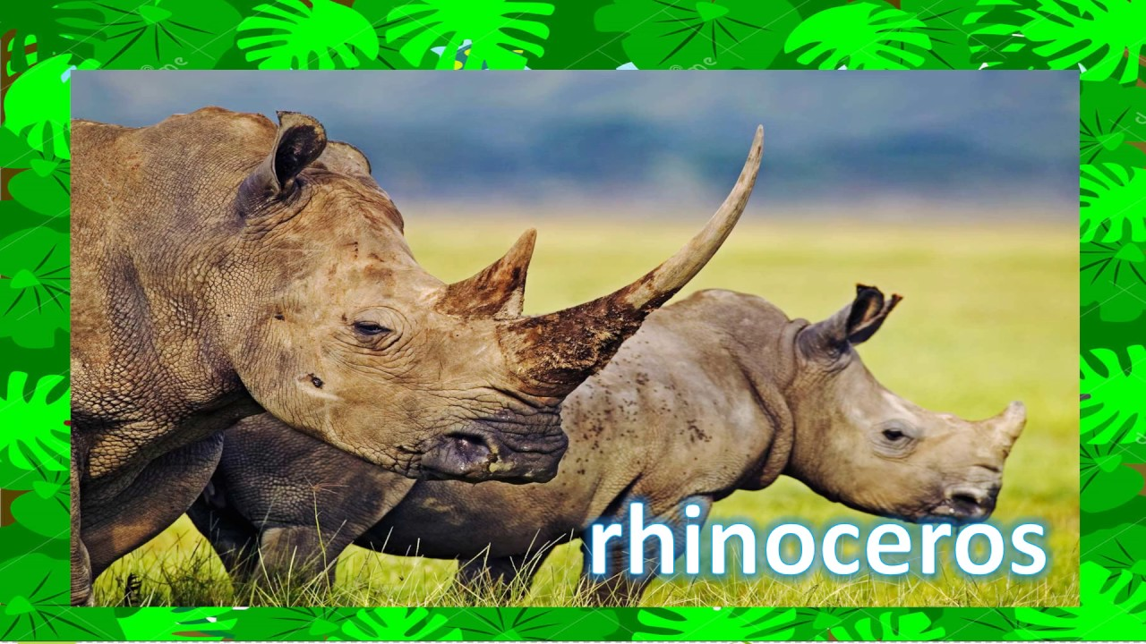

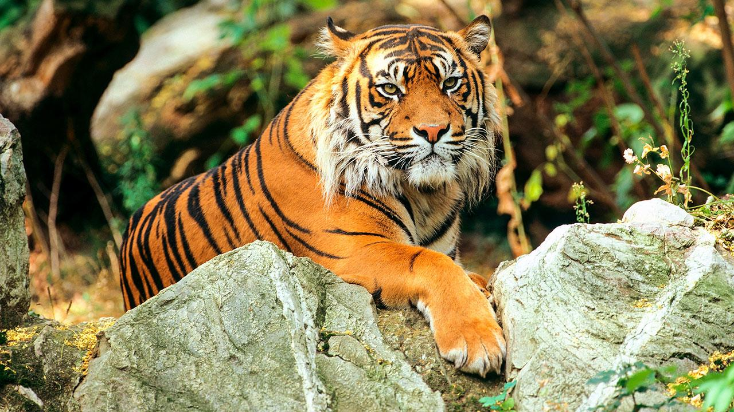
APPEARANCE

Slide 5
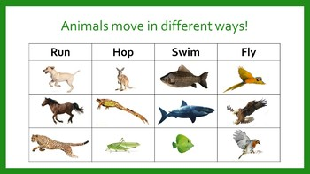
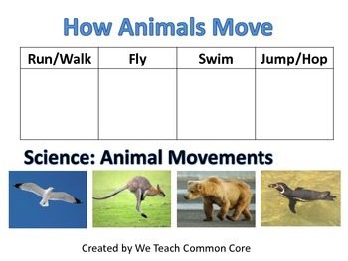
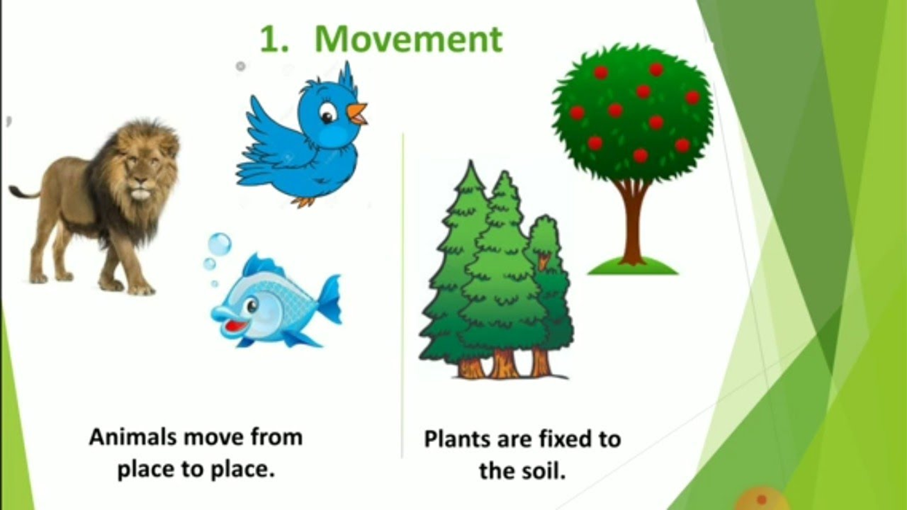
MOVEMENTS OF ANIMALS

Slide 6
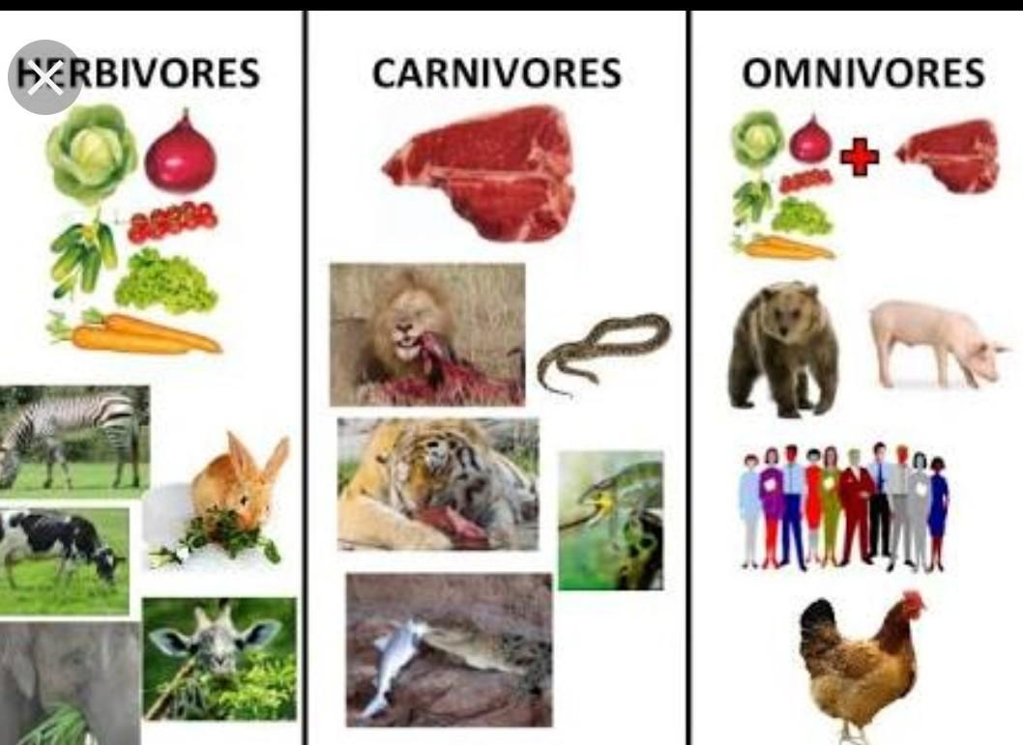
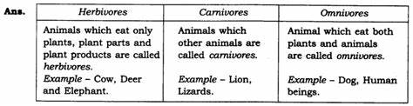
EATING HABITS OF ANIMALS

Slide 7
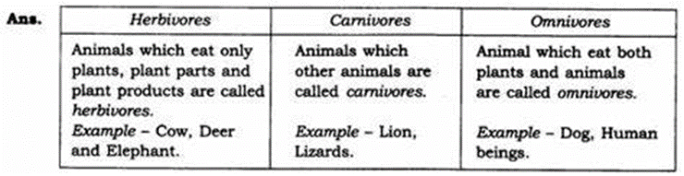
EATING HABITS

Slide 8
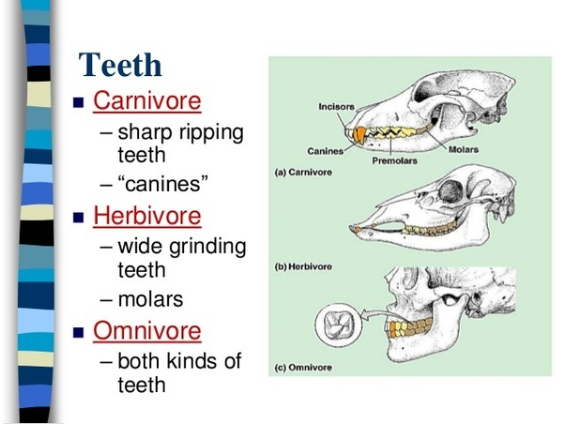
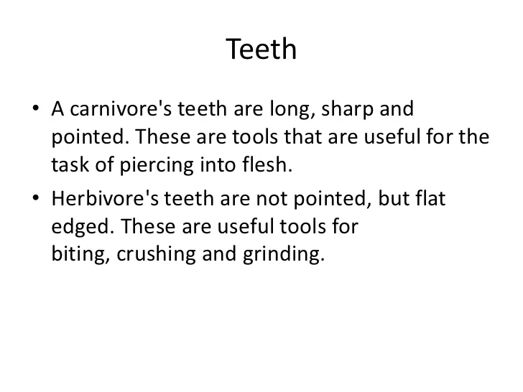
TEETH

Slide 9

CARING OF ANIMALS

Slide 10
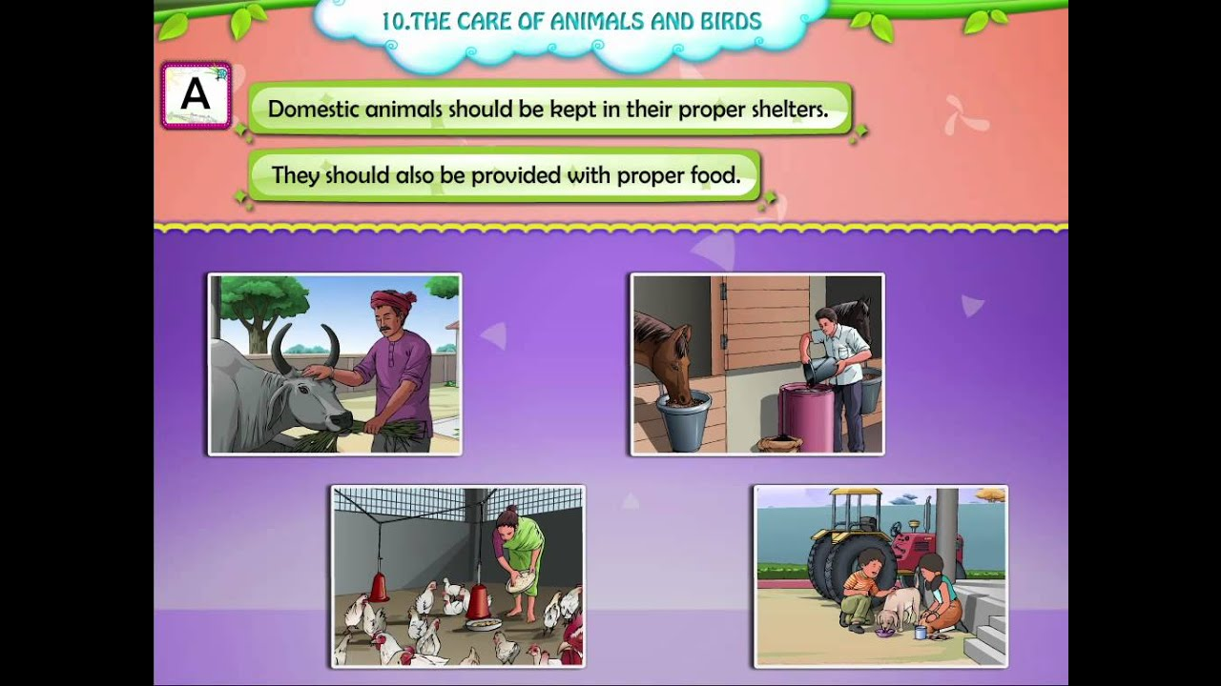

Slide 11


